Slide 1
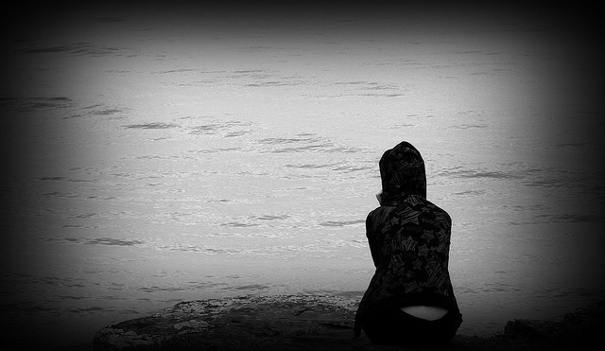
The Impossible Knife of Memory
By: Laurie Halse Anderson
Miss Miles, Period ?, May 5th 2014

Slide 2
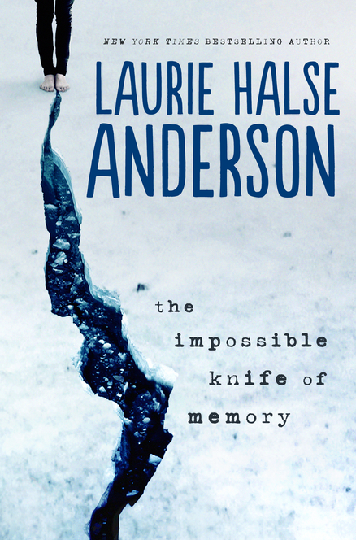
Summary
Hayley Kincaid and her father, Andy, have just moved back to his hometown after being on the road for 5 years. Hayley struggles to fit in at her new school because the experiences she has had have been so different from her classmates. She also struggles to see any hope of a future for herself. When her only friend, Gracie, introduces Hayley to Finn, the attractive editor of the school newspaper, Hayley starts to have a normal, teenage experience, and is able to start planning a future for herself.

Slide 3
The Plot Thickens
Hayley’s new life isn’t changed completely, however. Her dad is a war veteran from Afghanistan, and he is haunted every day by his experiences. Because he struggles so much, Hayley has to become the parent, take care of him, and make sure he doesn’t hurt himself. This makes it difficult for her to be the normal teenager that Finn is trying to help her become.

Slide 4
What I Liked
Even though this story is mostly told from Hayley’s point of view, there are small chapters throughout the story that are Andy’s memories from his time in Afghanistan. These parts help you understand better what Andy is going through. For example, chapter 34 says the following:
“They fired at our outpost, corrected the angle and fired again. And again. Every shot looked like a small, red flower blooming across the valley. They rained destruction on our heads, distracting us so that we weren’t ready for the men who poured into our camp, weapons blazing” (115).
This part vividly describes what Andy experienced, and it helps you as the reader sympathize with him.

Slide 5
Favorite Character
Hayley Kincaid
17 years old, tall lanky, blue-haired
Smart, compassionate, mature, but also skeptical and closed-off
Hayley’s love for her father is shown constantly throughout the book. Even when she is angry with him, you can still sense how much she cares. I liked Hayley the most because at one point in high school, I was very similar to her. I had to grow up fast like her; I cared deeply about my family members, but I also closed myself off to anyone at my new school. I was skeptical about my future. Reading her story was almost like reading my own diary.

Slide 6
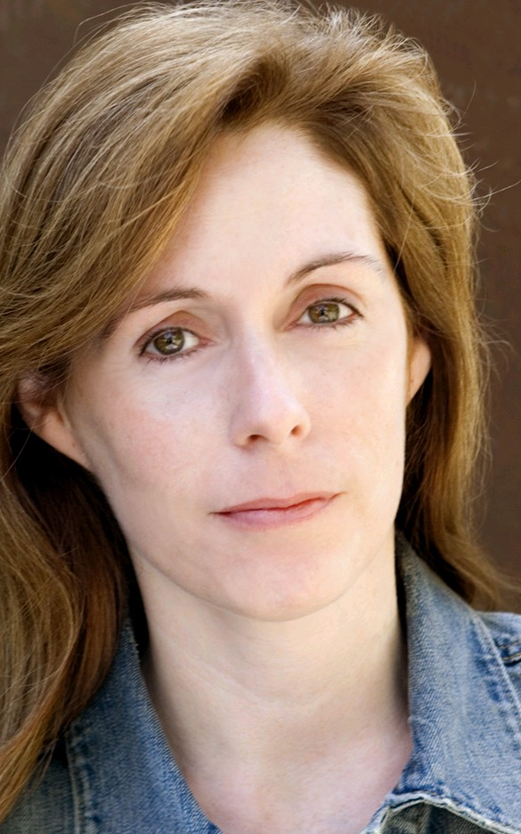
Other novels by Laurie Halse Anderson
Speak
Catalyst
Twisted
Wintergirls
Fever, 1793
and many more!

