Slide 1
Plot Pyramid Introduction

Slide 2
What is Plot?
The main points in a story presented in sequential order.
It also contains the setting and characters in the story.

Slide 3
What is Setting?
Setting is the time and place of the story.
Hogwarts 1997 is the setting for Harry Potter and the Deathly Hollows
Futuristic Chicago is the setting for Divergent
Present Day Indianapolis is the setting for The Fault in Our Stars

Slide 4
Characterization
Direct Characterization is when the author tells you specific characteristics of a character.
“Harry had a thin face, knobbly knees, black hair, and bright green eyes.”
Indirect Characterization is when the author describes the character, but doesn’t tell you exactly.
“Harry must have had more haircuts than the rest of the boys in his class put together, but it made no difference, his hair simply grew that way—all over the place.”
The Protagonist of a story is the main character in the story, or the hero of the story.
Harry Potter
The Antagonist(s) of a story is the character who actively opposes or is hostile to the main character; the adversary or the villain.
He-Who-Must-Not-Be-Named

Slide 5
The Plot Pyramid
Climax
Rising Action
Falling Action
Exposition
Resolution/Denoument
Complication/ Problem

Slide 6
The Plot Pyramid for The Wizard of Oz

Slide 7
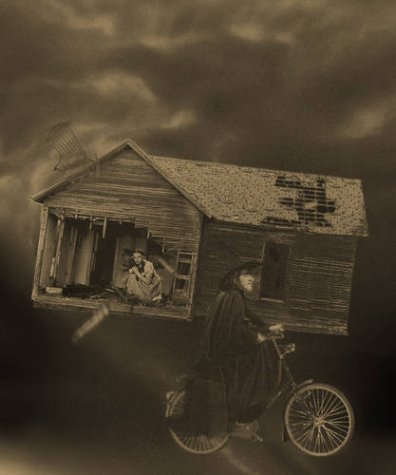
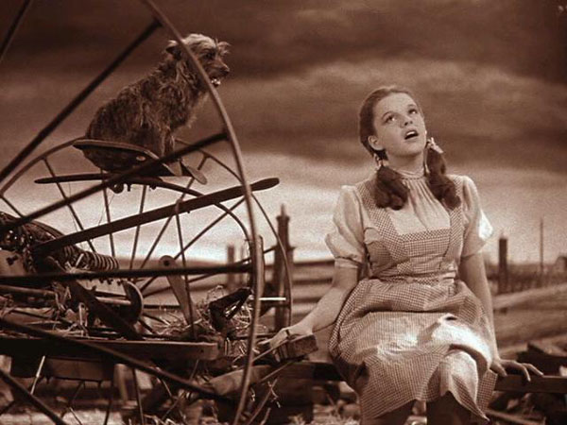
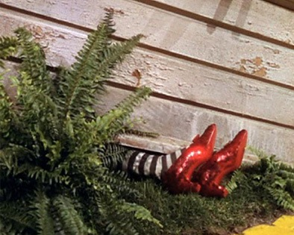
Exposition
The introduction to the story
In the Exposition, you learn the setting of the story and the main characters
The beginning events of the story that lead to the complication.

Slide 8
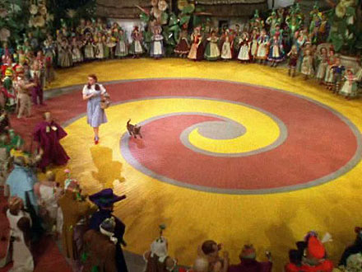
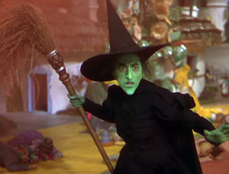
Complication/Problem
The complication is the problem in the story that the protagonist must solve. The complication adds the conflict to the story, which is created by the antagonist.

Slide 9
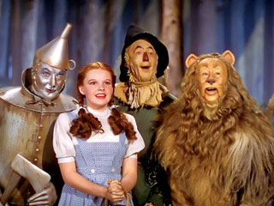
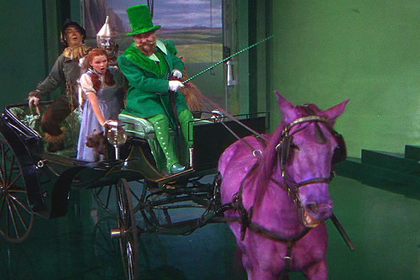
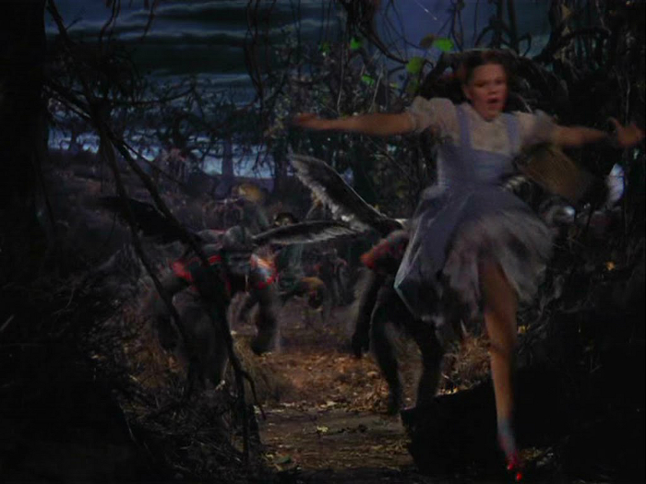
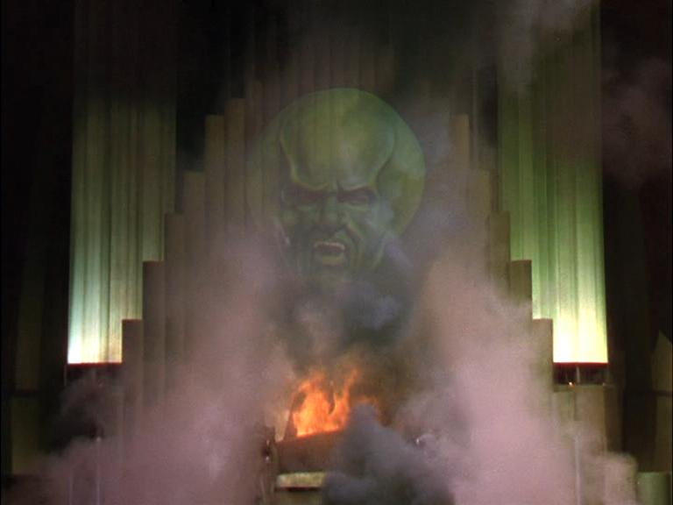
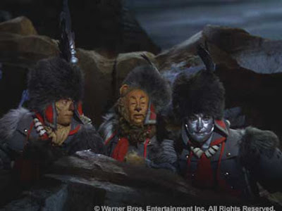
Rising Action
The Rising Action consists of all of the events leading to the climax of the story. These events build tension to the story.

Slide 10
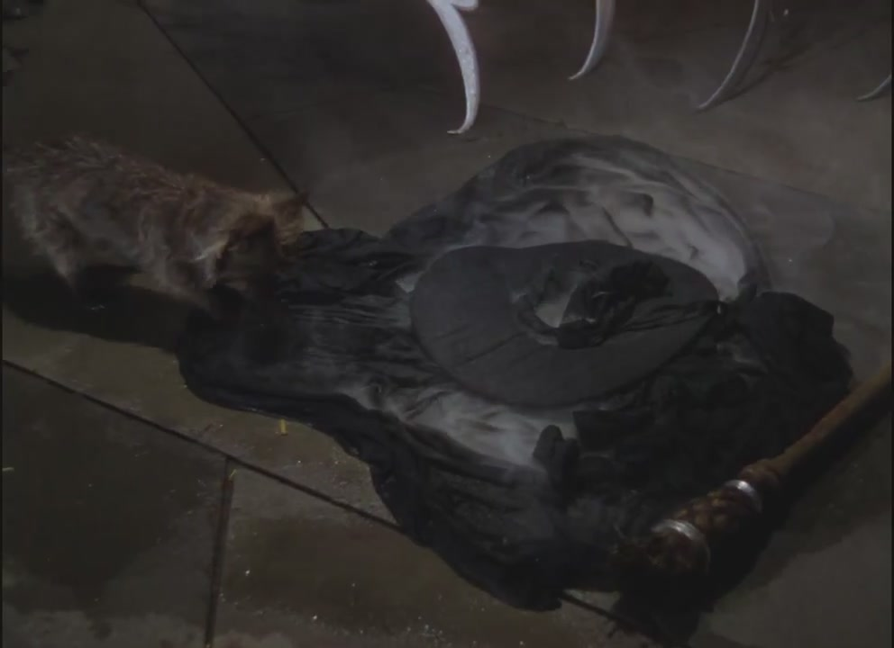
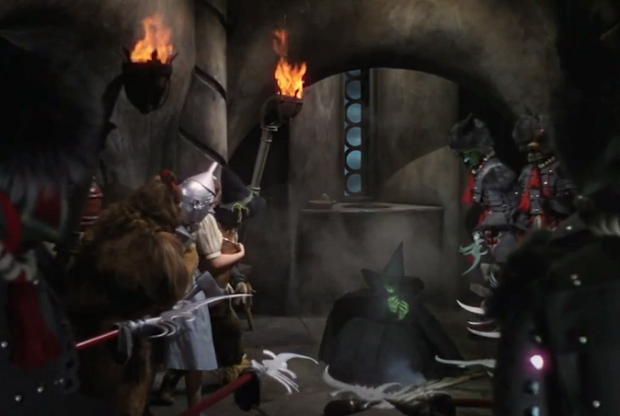
Climax
The most exciting part of the story, when the problem is solved.

Slide 11
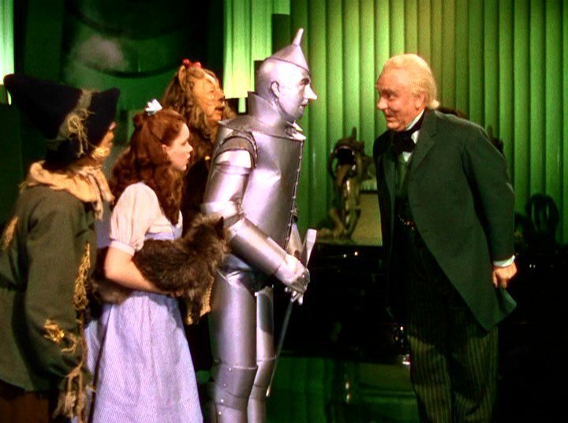
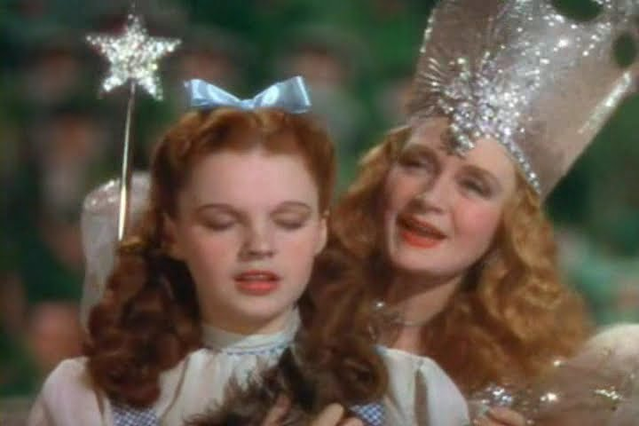
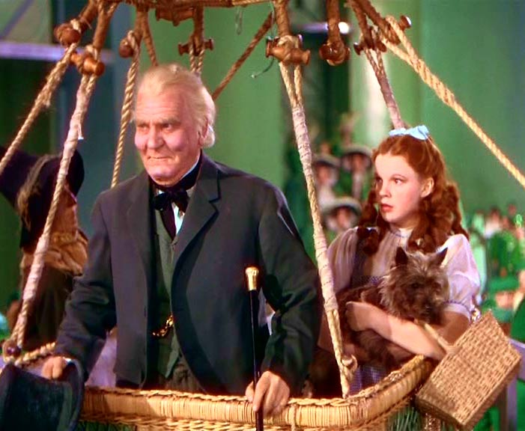
Falling Action
The Falling Action are the events leading to the resolution of the story. There aren’t as many events here as there are in the rising action.

Slide 12
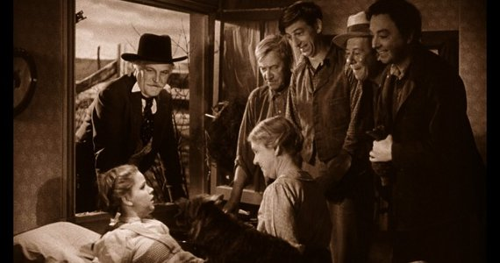
Resolution/Denoument
The Resolution is the ending to the story and how everything wraps up.

Slide 13
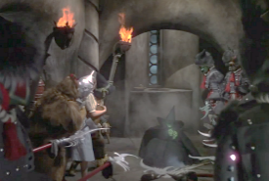
Climax
Rising Action
Falling Action
Exposition
Resolution/Denoument
Complication/ Problem

