Slide 1
Bell Ringer!
Grab your notebook from the front of the room.
After watching Channel One, write a 3-5 sentence summary of your favorite news story.

Slide 2
What is Journalism?

Slide 3
What types of writing do you do in Language Arts?

Slide 4
What types of writing do you see in a newspaper or magazine?

Slide 5
How are these different?

Slide 6
Journalism is…
Wikipedia’s definition: The gathering, processing, and distributing of news and information about news to an audience.
Miss Miles’ definition: The gathering and processing of the everyday events happening everywhere to help us understand the world and society better.

Slide 7
Where are we headed this semester?
What is Journalism?
Newswriting and the Inverted Pyramid
Features and Photography
Sports Writing
The Op-Ed Section (editorials and columns)
***All of these concepts are used by yearbook staff members!!

Slide 8
Journalism Basics

Slide 9
First things first!
What is more important in a news story: facts or opinions?
When reporting an event, journalists must be careful to state the facts of a story, and stay away from opinions. It builds your credibility.

Slide 10
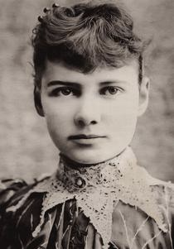
Roles of a Journalist and the Media
Journalists were muckrakers.
Muckraking: journalists from the early 20th century who attempted to expose the abuses of businesses and corruption in politics.
They informed the public about what businesses and politics were doing wrong.

Slide 11
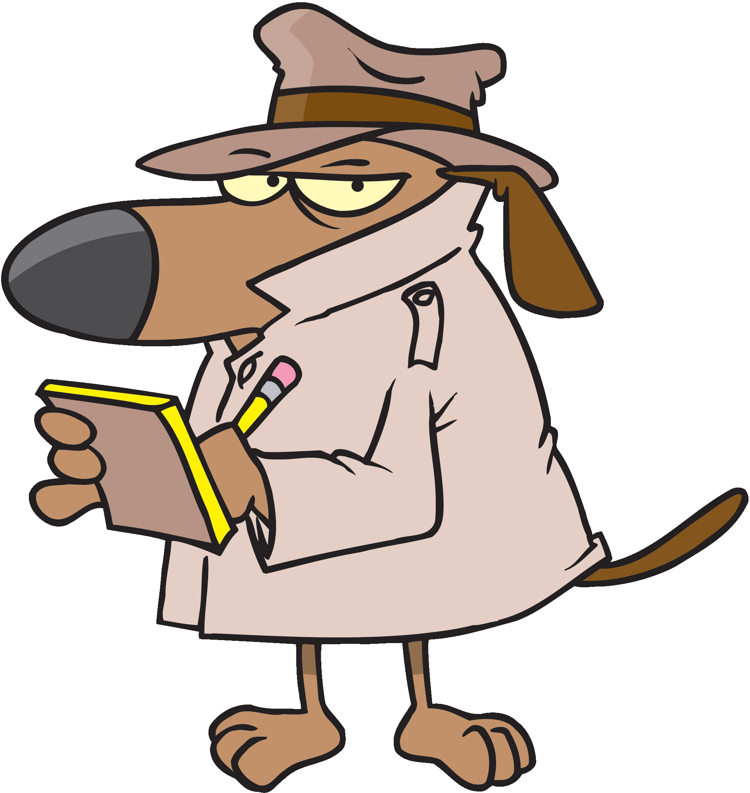
Roles of a Journalist and the Media
Journalists are watchdogs.
Watchdog reporting: journalists act as protectors or guardians against inefficiency in matters of public interest.
Basically, journalists who inform the public about what is happening. Usually, they are your news reporters.

Slide 12
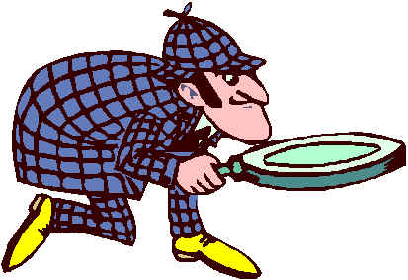
Roles of a Journalist and the Media
Journalists are investigators.
Investigative reporting: a form of reporting where journalists deeply investigate a single topic of interest through multiple sources and fact checking.
Investigative reporters usually are your feature writers.

